Slide 1
Computer Vision and Pattern Recognition
CS 4243
Assignment5: Tracking
Deadline: 31 Oct 2019
TA: Yu Ziwei
yuziwei@u.nus.edu
Notes:
What is the segmetation.

Slide 2
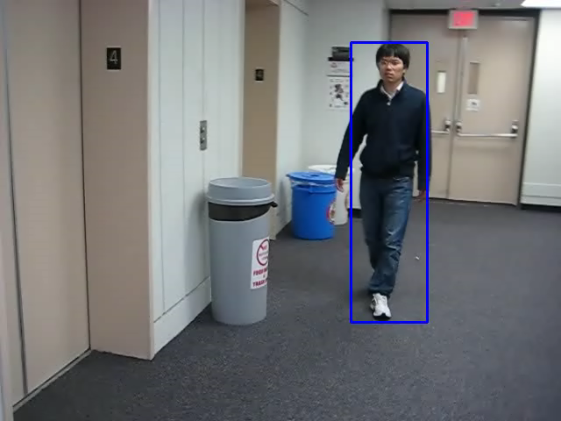
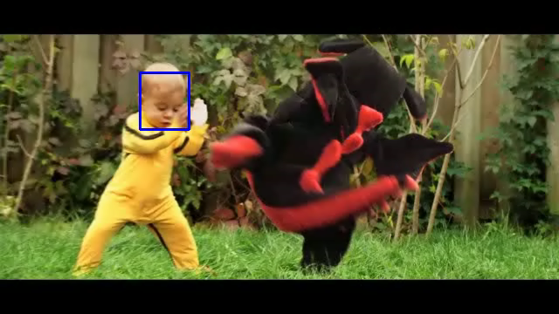
Tracking
A feature is a specific point in the image that a tracking algorithm can lock onto and follow trough multiple frames ----Wikipedia

Slide 3
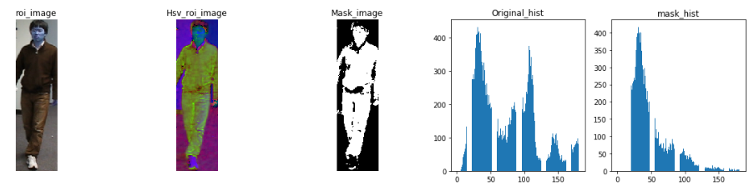
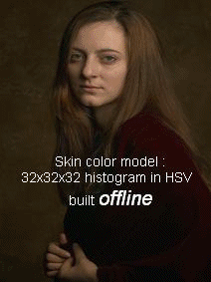
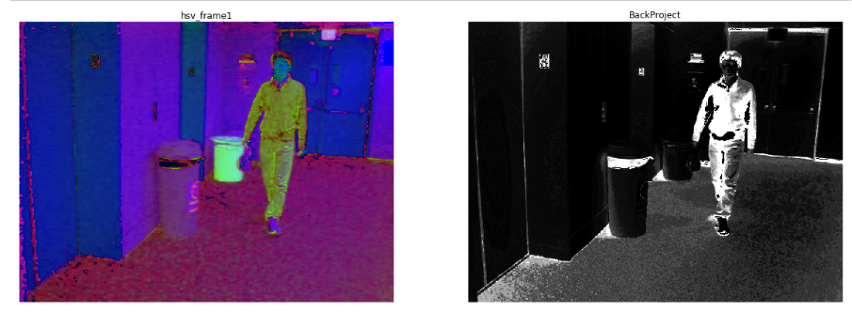
Task #1: Mean Shift Method

Slide 4
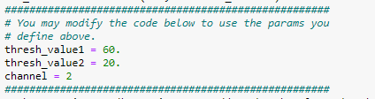
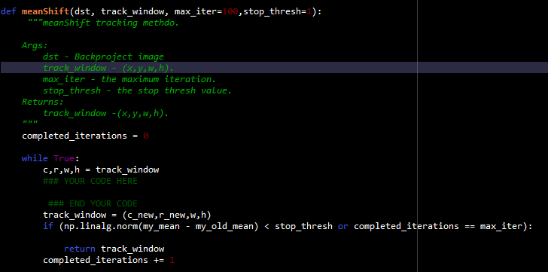
Task #1: Mean Shift Method
You need to finish:
Tune your parameter, You will full marks for IoU score > 0.65.

Slide 5
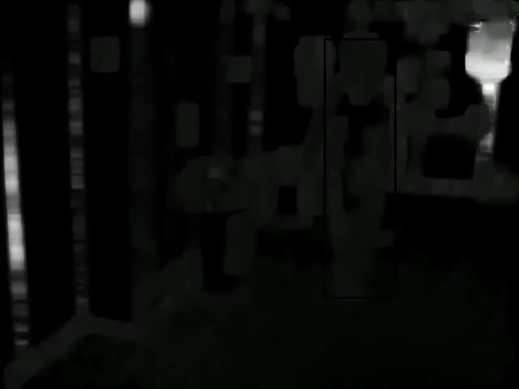
Task #2: Lucas-Kanade Method for Optical Flow
Optical flow

Slide 6
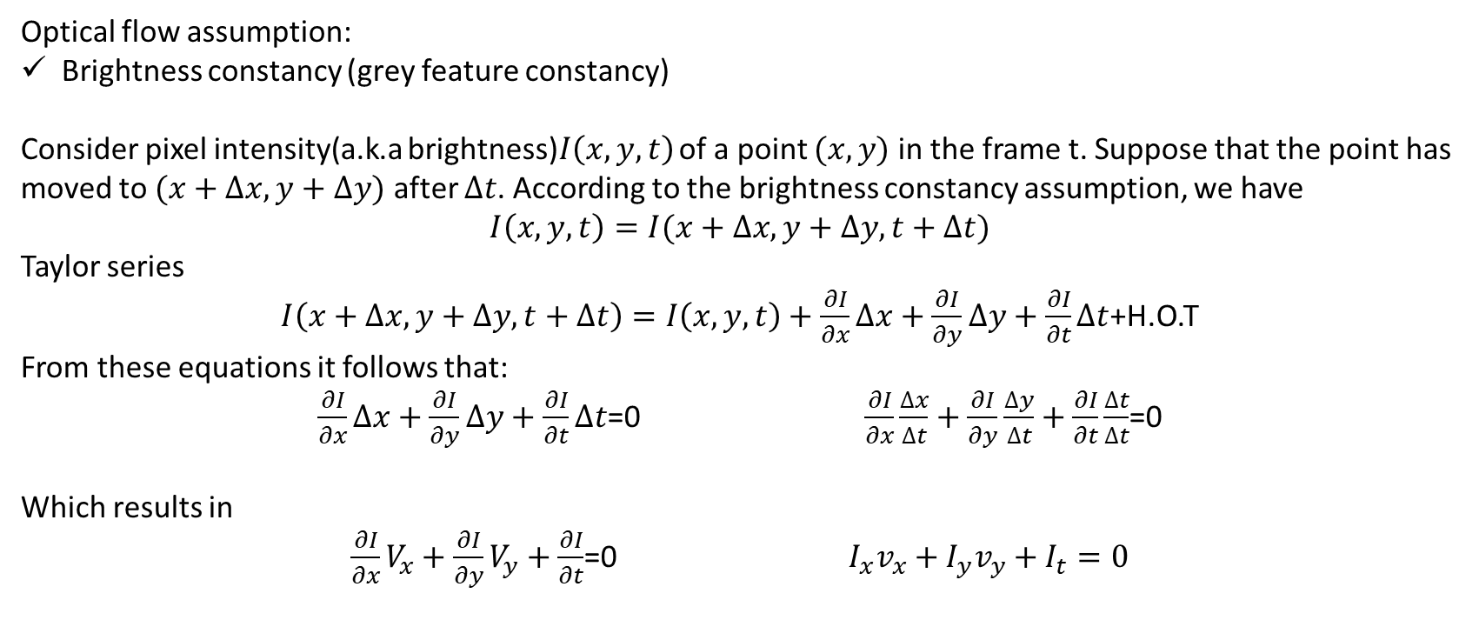
Task #2: Lucas-Kanade Method for Optical Flow
Optical flow is the pattern of apparent motion of objects, surfaces, and edges in a visual scene caused by the relative motion between an observer and a scene.
---- Wikipedia
Optical flow assumption:
Brightness constancy (grey feature constancy)
Consider pixel intensity(a.k.a brightness)$I\left(x,y,t\right)$ of a point $(x,y)$ in the frame t. Suppose that the point has moved to $(x+∆x,y+∆y)$ after $∆t$. According to the brightness constancy assumption, we have
$I\left(x,y,t\right)=I(x+∆x,y+∆y,t+∆t)$
Taylor series
$I\left(x+∆x,y+∆y,t+∆t\right)=I\left(x,y,t\right)+\frac{∂I}{∂x}∆x+\frac{∂I}{∂y}∆y+\frac{∂I}{∂t}∆t$+H.O.T
From these equations it follows that:
$\frac{∂I}{∂x}∆x+\frac{∂I}{∂y}∆y+\frac{∂I}{∂t}∆t$=0 $\frac{∂I}{∂x}\frac{∆x}{∆t}+\frac{∂I}{∂y}\frac{∆y}{∆t}+\frac{∂I}{∂t}\frac{∆t}{∆t}$=0
Which results in
$\frac{∂I}{∂x}V_{x}+\frac{∂I}{∂y}V_{y}+\frac{∂I}{∂t}$=0 $I_{x}v_{x}+I_{y}v_{y}+I_{t}=0$

Slide 7
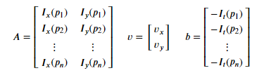
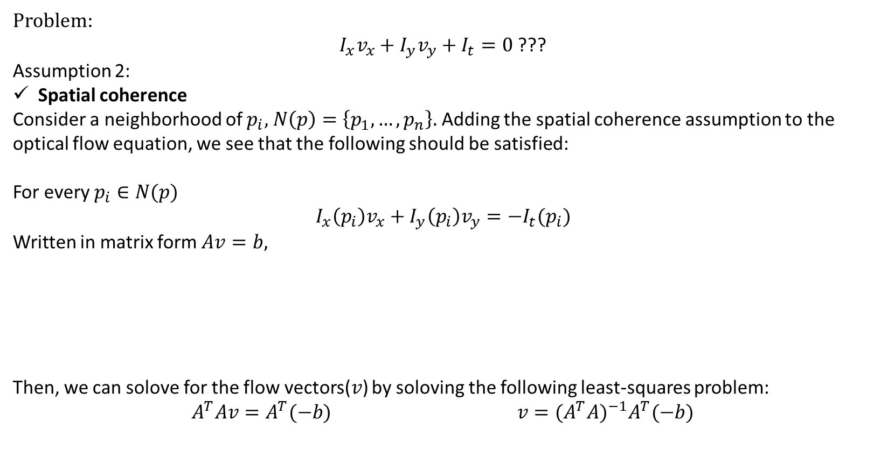
Task #2: Lucas-Kanade Method for Optical Flow
Problem:
$I_{x}v_{x}+I_{y}v_{y}+I_{t}=0$ ???
Assumption 2:
Spatial coherence
Consider a neighborhood of $p_{i},$ $N\left(p\right)=\left\{p_{1},…,p_{n}\right\}.$ Adding the spatial coherence assumption to the optical flow equation, we see that the following should be satisfied:
For every $p_{i}∈N(p)$
$$I_{x}\left(p_{i}\right)v_{x}+I_{y}\left(p_{i}\right)v_{y}=−I_{t}(p_{i})$$
Written in matrix form $Av=b,$
Then, we can solove for the flow vectors($v$) by soloving the following least-squares problem:
$A^{T}Av=A^{T}(−b)$ $v=(A^{T}A)^{−1}A^{T}(−b)$

Slide 8
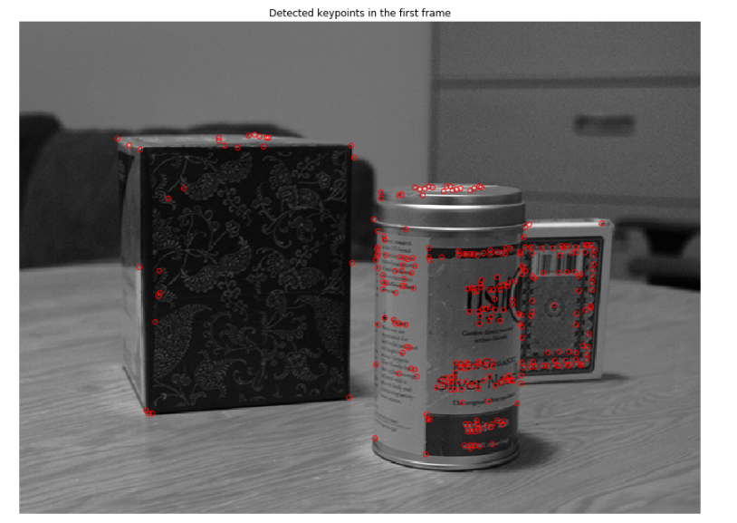
Task #2: Lucas-Kanade Method for Optical Flow
Harris corner detector
(a) Frame 1

Slide 9
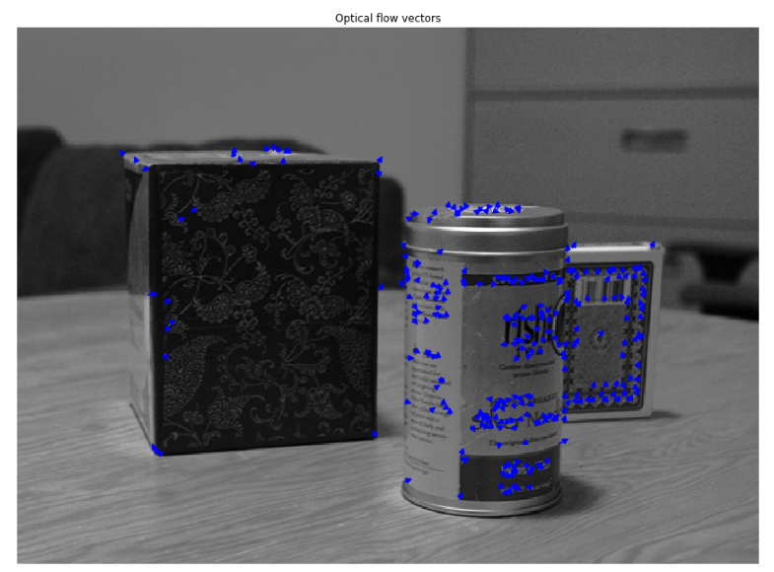
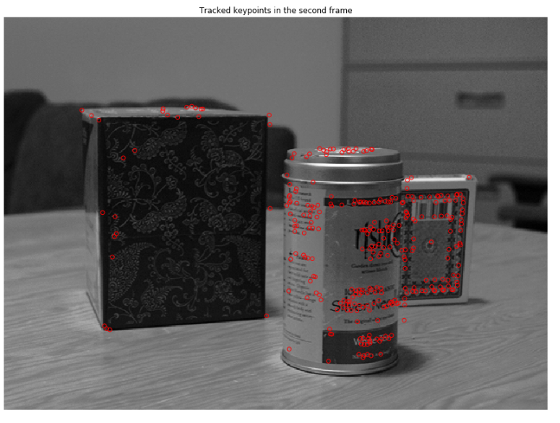
Task #2: Lucas-Kanade Method for Optical Flow
Use the Harris corner as the keypoints
(a) Frame 1
(a) Frame 2

Slide 10
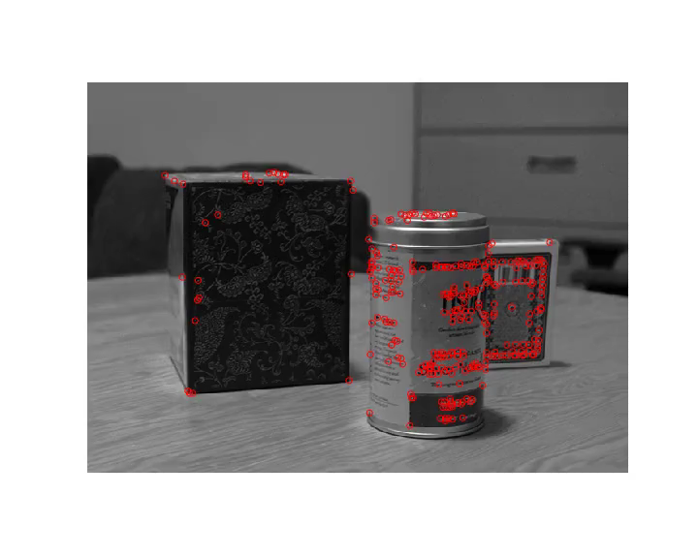
Task #2: Lucas-Kanade Method for Optical Flow
Use the Harris corner as the keypoints in multiple frames

Slide 11
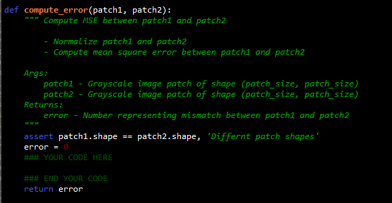
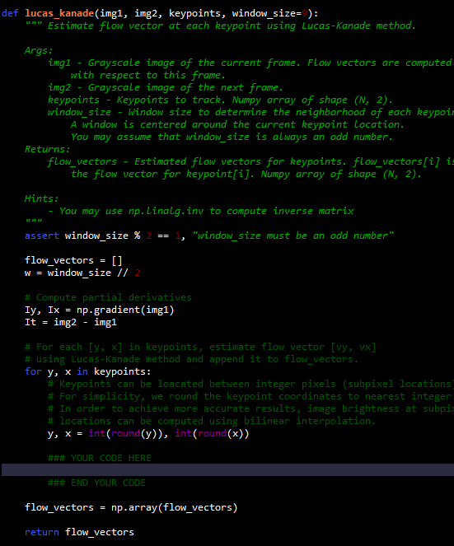
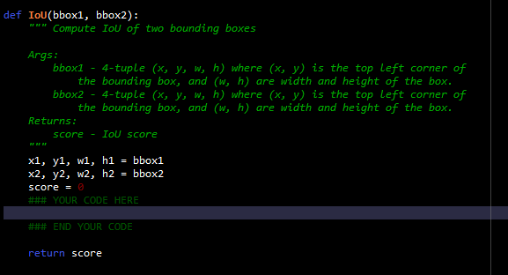
Task #2: Lucas-Kanade Method for Optical Flow
You need to finish:

Slide 12
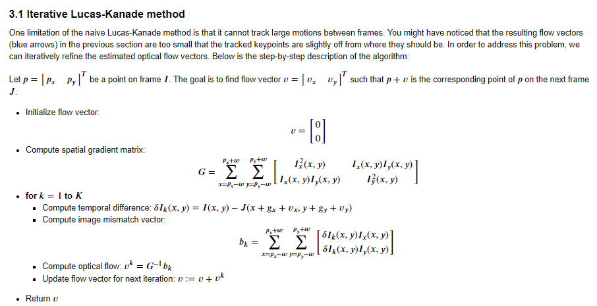
Task #3: Pyramidal Lucas-Kanade Feature Tracker method
Problem: The naive Lucas-Kanade method is that it cannot track large motions between frames.
3.1 Iterative Lucas-Kanade method

Slide 13
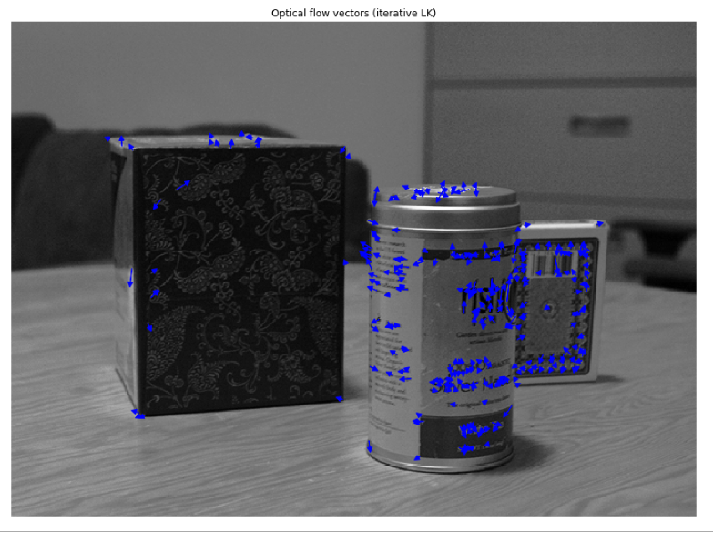
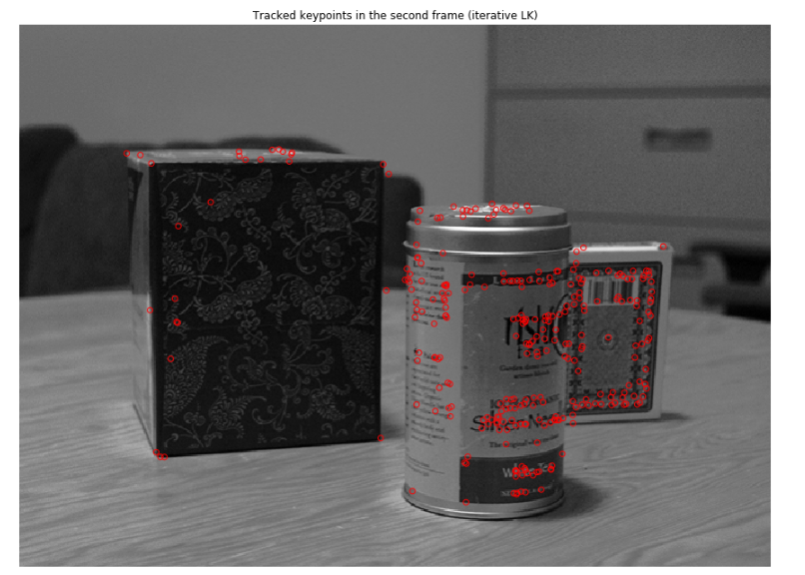
Task #3: Pyramidal Lucas-Kanade Feature Tracker method

Slide 14

Task #3: Pyramidal Lucas-Kanade Feature Tracker method
Use tge Iterative Lucas-Kanade method in multiple frames

Slide 15
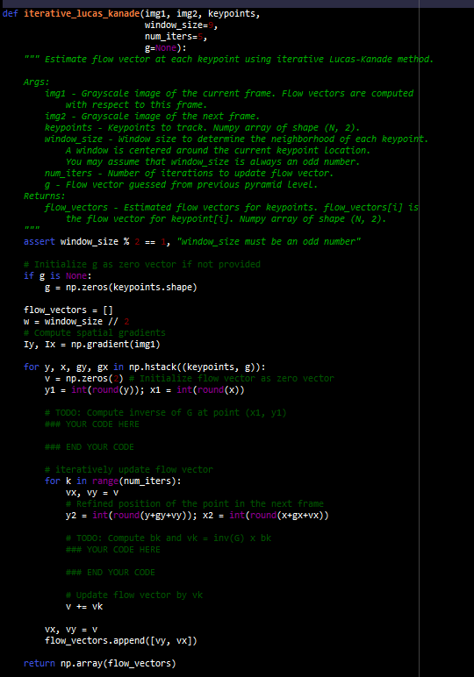
Task #3: Pyramidal Lucas-Kanade Feature Tracker method
You need to finish:

Slide 16
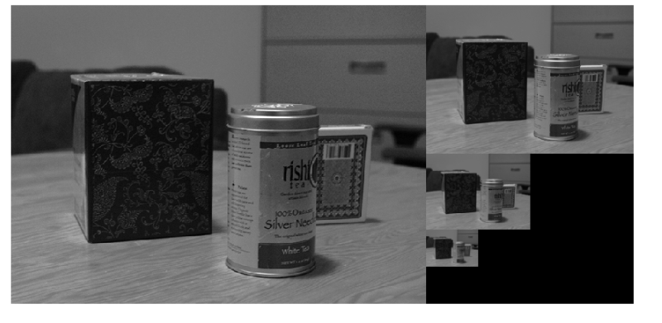
Task #3: Pyramidal Lucas-Kanade Feature Tracker method
3.2 Coarse-to-Fine Optical Flow

Slide 17
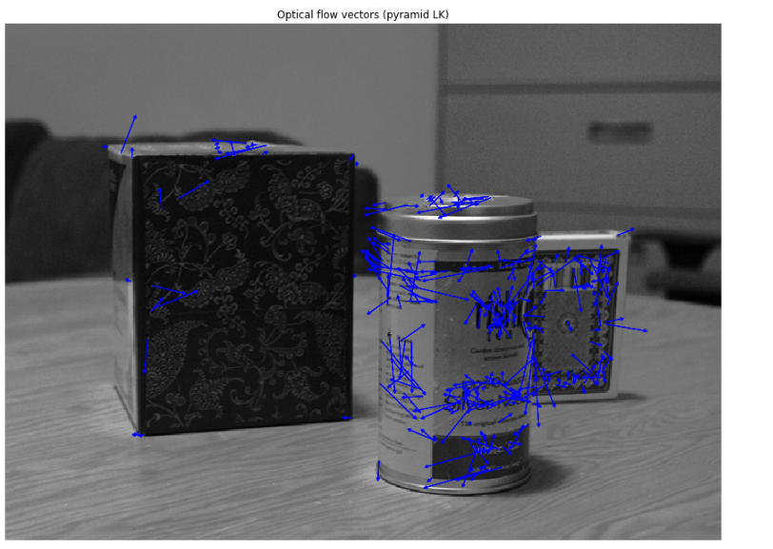
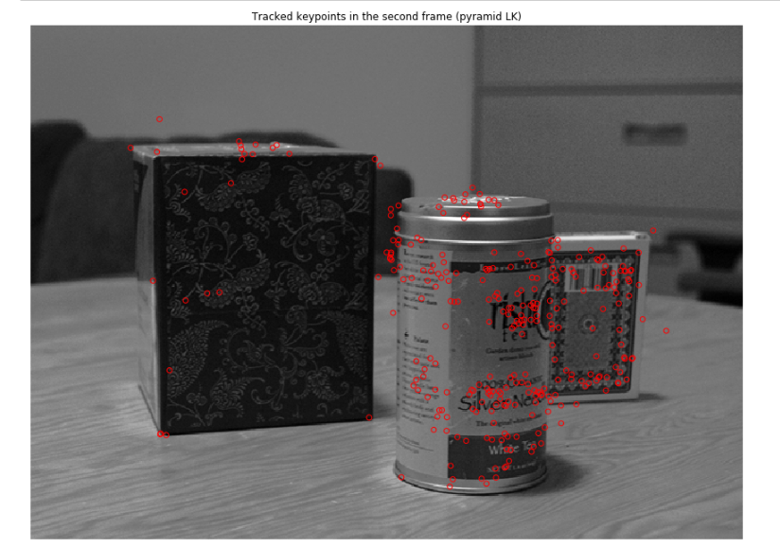
Task #3: Pyramidal Lucas-Kanade Feature Tracker method
3.2 Coarse-to-Fine Optical Flow

Slide 18
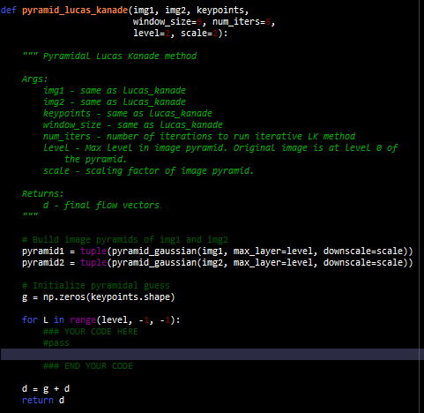
Task #3: Pyramidal Lucas-Kanade Feature Tracker method
You need to finish:

Slide 19
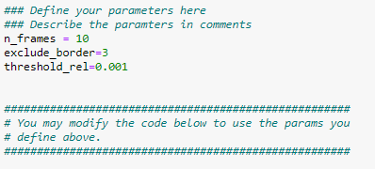
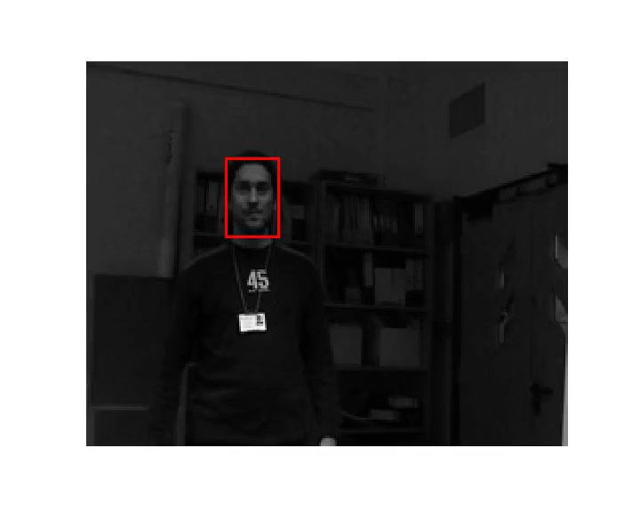
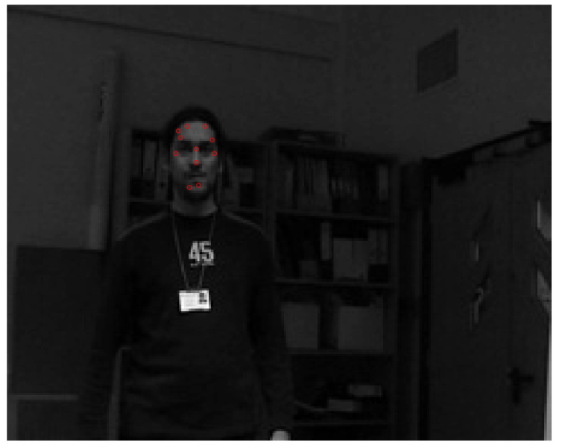
Task #4: Object Tracking
You need to design your own object tracker
If your IoU score > 0.35, you can get full marks.

Slide 20
Reference:
calcHist function : https://docs.opencv.org/2.4/modules/imgproc/doc/histograms.html
calBackProject function: https://docs.opencv.org/3.4/da/d7f/tutorial_back_projection.html
Numpy.gradient: https://docs.scipy.org/doc/numpy/reference/generated/numpy.gradient.html

